Slide 1
Outline:

Slide 2
Introduction
Objective:
Method of computing a trajectory that describes the desired motion of a manipulator in multidimensional space.
Trajectory: Time history of position, velocity and acceleration of each DoF.
It is easier to the user to specify first and last points, or some points that the robot must pass and the system (control unit) should determine the details, such as curve shape, intermediate velocities, …

Slide 3
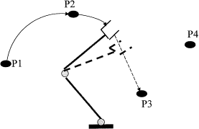
General Considerations
The motion of the manipulator ≡ the motion of the tool frame {T} relative to the station frame {S}.
Basic Problem (P2P): move the manipulator from initial point to final point. Point ≡ position and orientation of {T} relative to {S}.
Via Points: intermediate points between the initial and final positions that the robot must pass through.
Path points
Initial point
Final point
Also the time between points could be specified

Slide 4
General Considerations
Usually the motion of the robot is smooth
Smooth trajectory functions ≡ continuous, continuous first derivative, and the second derivative (some times)
Otherwise: high jerk ➔ wear↑, vibration↑, noise, …
Constraints on the motion
These paths should conform to the mentioned constraints
Too many functions that can be used.
In this chapter simple approaches are used

Slide 5
Joint-Space Scheme
Path shapes are described in terms of functions of joint angles
The user desires to move the robot from one point another (Cartesian space) ➔ Inverse kinematics ➔ joint space (joint angles that correspond to the first and last points of the path or via points).
➔ for each joint a smooth function is calculated conforming to path points

Slide 6
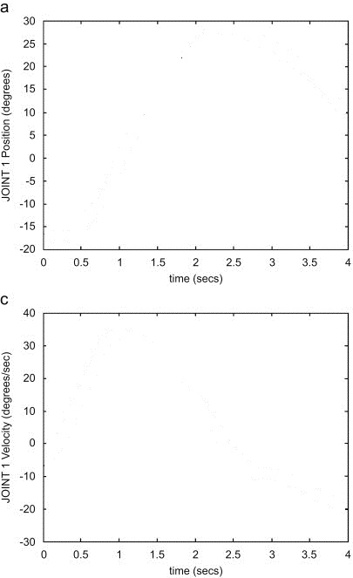
Joint-Space Scheme
Inverse kinematics
1
2
3
4
First Stage
Inverse kinematics
1
2
3
4

Slide 7
Joint-Space Scheme
Inverse kinematics
1
2
3
4
Second Stage
Smooth functions for each joint
1
2
3
4

Slide 8
Joint-Space Scheme
Inverse kinematics
1
2
3
4
Direct kinematics
Third Stage
Direct kinematics (if needed)
e.g.: obstacle avoidance
1
2
3
4

Slide 9
Joint-Space Scheme
Path functions:
Cubic polynomial: (P2P)
The initial and final positions of the robot are known. (The robot is needed to move from an initial position to a final one).
And also the velocity at t = 0 and t = t_{f} (zero velocities)
➔ For each θ ➔ 4 conditions ➔ Cubic polynomial of 4 unknowns can be used.
Known

Slide 10
Joint-Space Scheme
Path functions:
Cubic polynomial: (P2P)
The initial and final positions of the robot are known. (The robot is needed to move from an initial position to a final one).
And also the velocity at t = 0 and t = t_{f} (zero velocities)
➔ For each θ ➔ 4 conditions ➔ Cubic polynomial of 4 unknowns can be used.
Known

Slide 11
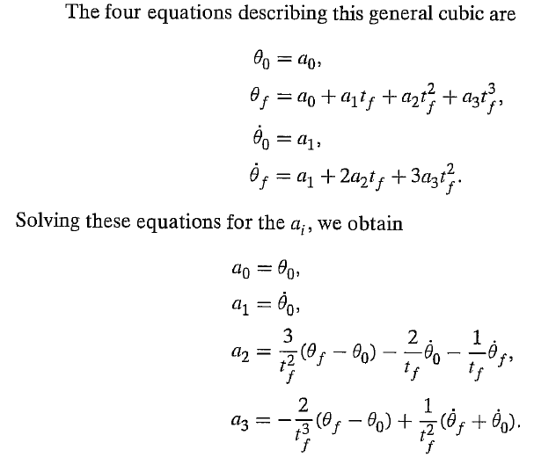
Joint-Space Scheme
Path functions: Cubic polynomial: (P2P)
See example 7.1

